Slide 1

Thanks Robert More for an interesting project

Slide 2

Traditional File Sharing Methods
The BitTorrent Idea
The BitTorrent Protocol
Project 1 Basics

Slide 3

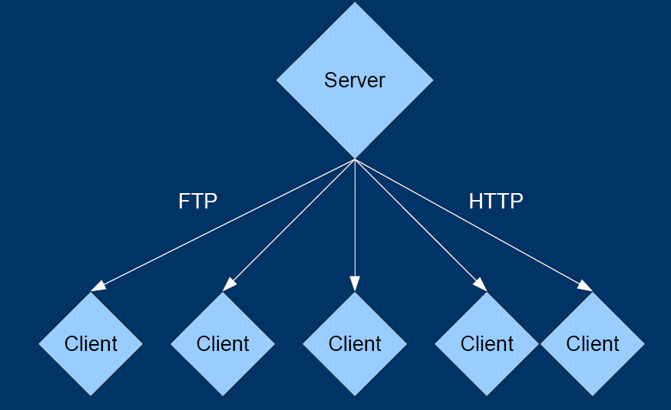
Benefits
  Simple
  File Updates
  Small Files
  Few Clients
Drawbacks
  Saturated Server
  Upstream
  Unused Client Upstream
  File Size
  Many Clients

Slide 4

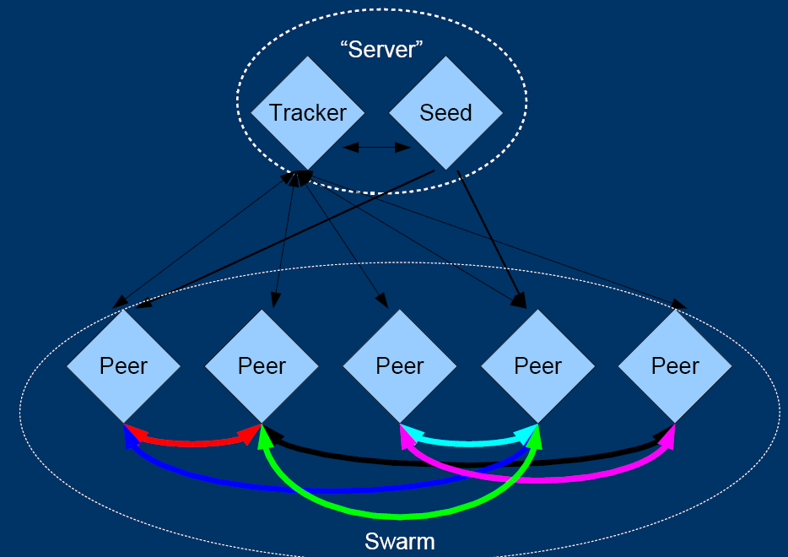

Slide 5

● Main Ideas
– Peers “Serve” Each Other
– Server is Split Into Tracker & Peer (Seed)
● Benefits
– Uses Peer Upstream
– Increases Peer Downstream1
– Reduces Seed Upstream2
● Drawbacks
– Multiple Simultaneous Connections
– Client Upstream Use Can Saturate Pipe

Slide 6
Connections
● Tracker/Peer
– Metainfo Only
– Low Bandwidth
– Many Simultaneous Connections (Tracker)
● Peer/Peer
– Communication/Data
– Variable Bandwidth
– Single Connection Between Peers
– Multiple Peers Connected Simultaneously

Slide 7

● Tracker Requests are HTTP_GET
● Tracker Responses are Bencoded
● All Peer Traffic is Bencoded
● Files Broken into Pieces
● Pieces are Hashed to Verify Integrity

Slide 8

● HTTP_GET
– Standard HTTP Request
– Send “Info Hash” and Peer ID as Escaped Text
“ “ => %20
$ => %24
● Bencoding – Binary Encoding
– Integers “i-123e”
– Strings “5:Hello”
– Lists “l<Bencoded Objects>e”
– Dictionaries “d<Key><Value><K><V>...e”
– Bencoder.java Available

Slide 9

● Simple Client (No Upload)
1.Open .torrent Metainfo File
2.Contact Tracker with Info Hash and Peer ID
3.Receive List of Peers and Announce Interval
4.Contact Peer(s)
5.Request Pieces
6.Verify Pieces (SHA-1 Hash)
7.Save Data to Local Disk

Slide 10

● General Outline
1.Metainfo File is Parsed (TorrentFileHandler.java)
2.Generate Random Peer ID
3.Contact Tracker with Info Hash and Peer ID
4.Select Peer at 128.6.60.*
5.Communicate With Peer
6.Download and Verify All Pieces
7.Save to File

Slide 11

● Parsing .torrent Metainfo File
– TorrentFileHandler.openTorrentFile(String)
– TorrentFile object
● String tracker_url
● Vector<byte[]> piece_hash_values_as_binary
● String info_hash_as_url
● int file_length
● int piece_length
● Generate Random Peer ID
– Java.Random class
– Generate Random int and Convert to Alphanumerics

Slide 12
● Contact Tracker with Info Hash and Peer ID
– HTTP GET Request
– HTTP Escaped Strings, Key/Value Pairs
– GET …/announce?info_hash=<hash>&peer_id=<id>
● Tracker Response as Bencoded text/plain

Slide 13
● Select Peer at 128.6.60.*
– Tracker Returns Bencoded List of Dictionaries
● Peer ID, IP, Port
● Vector Bencoder.unbencodeList(byte[])
● HashMap Bencoder.unbencodeDictionary(byte[])
● BencoderTester.java

Slide 14

● Communicate With Peer
– Handshake
<pstrlen><pstr><reserved><info_hash><peer_id>
– General Messages
<length prefix [4B dec]><message ID[1B char]><payload>
– Request Piece
<0013><6><index><begin><length>
● Index of Piece
● Offset of Block
● Length of Block (214 default)

Slide 15
● Download and Verify All Pieces
– SHA-1 Hash (160 bits)
MessageDigest.getInstance("SHA-1");
byte[] hash = sha.digest(bytes);
● Save to File
– FileOutputStream.write(byte[])

Slide 16
● Info Hash
– SHA-1 Hash of Bencoded Info (TorrentFileHandler)
● Piece Hash
– Must Generate SHA-1 Hash of Each Piece
● Peer ID
– Must Generate Randomly
● Bencoding
– Encode/Decode with Bencoder.java

Slide 17

Read the input TorrentFile , and store information into a class
  - Use Bencoder.java
Analyze the HTTP response from tracker to find the peer.
Implement hand-shake protocol between peer-to-peer.
Request piece and receive piece.

Slide 18

● Classmates
● Internet
– http://remus.rutgers.edu/cs352/F07/project1/project1.html
● Email
– tphan@cs.rutgers.edu
● Office Hours
– Thu 7-8pm Hill 367
● Due Date: Mon 15 Oct, 2007 11:59pm

